Slide 1
Object-Oriented Programming (OOP)
Week – 14
May 18-22, 2020
Instructor: Basit Ali
Email: basit.jasani@nu.edu.pk
Object-Oriented Programming (OOP)

Slide 2
Vectors
The vector class simply provides a dynamic array i.e. an array that can grow as needed
Vectors allocates memory when needed
Although a vector is dynamic, we can still use normal array syntax to access its elements

Slide 3
Advantages of Vectors
The size of a vector does not have to be a fixed constant, and it can also grow or shrink during execution. If you want to read data from a file and store it in an vector, you can just keep adding new elements as you receive them, without having to know what the largest amount would be
A vector always knows its own size, so passing one to a function does not require you to separately pass this information
Elements can be accessed by position in a vector just as they are in an array, but you can also insert and remove elements anywhere in a vector
Vectors can be returned from a function easily

Slide 4
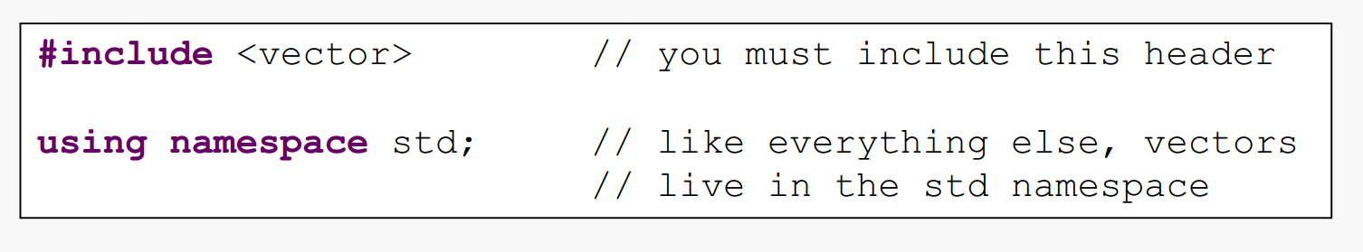
Library

Slide 5
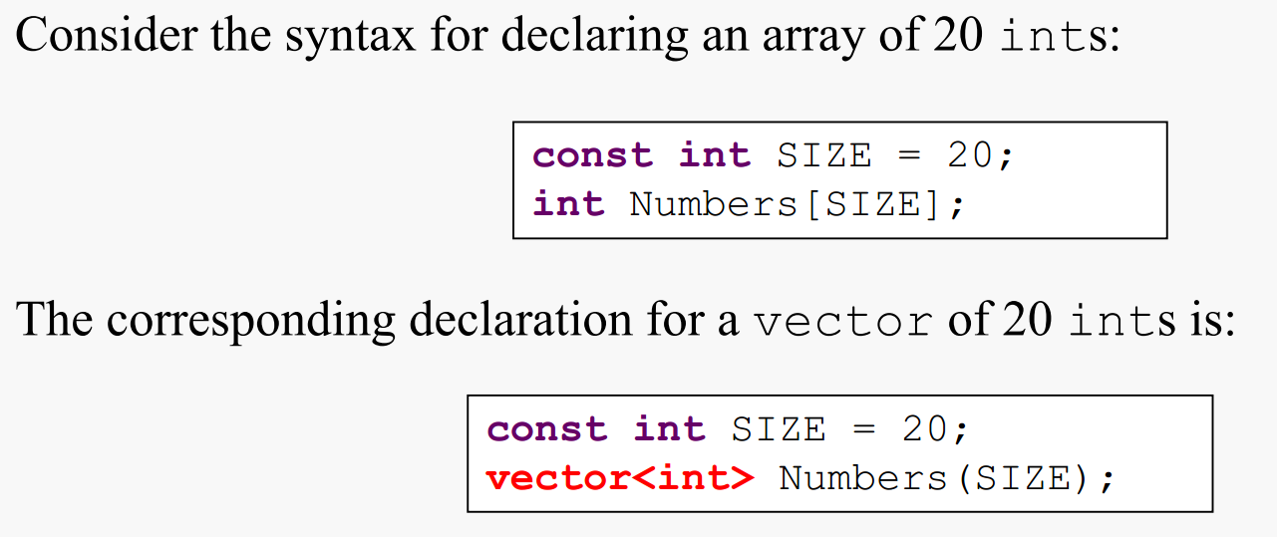
Declaring a Vector
Unlike an array, the elements of a vector are initialized with appropriate default values. This means 0 for ints, 0.0 for doubles, and “” for strings.

Slide 6
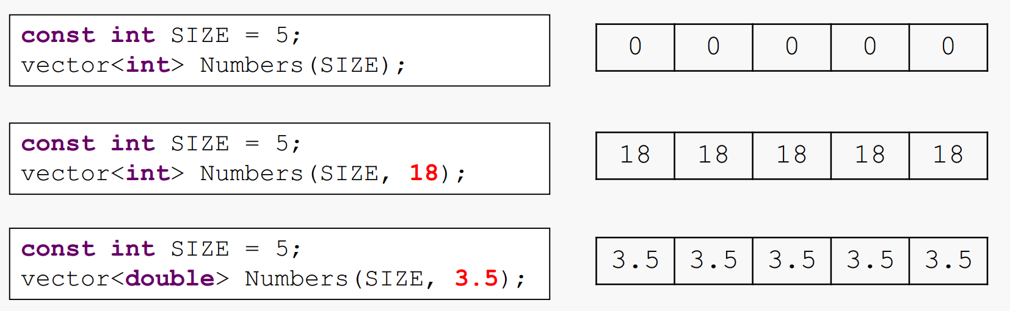
Initializing a Vector

Slide 7
Some useful functions in Vector class
Some of the most commonly used member functions are size( ), begin( ), end( ), push_back( ), insert( ) erase( ), empty(), resize(), clear() and pop_back()
Many other functions and their overloaded versions are also available

Slide 8
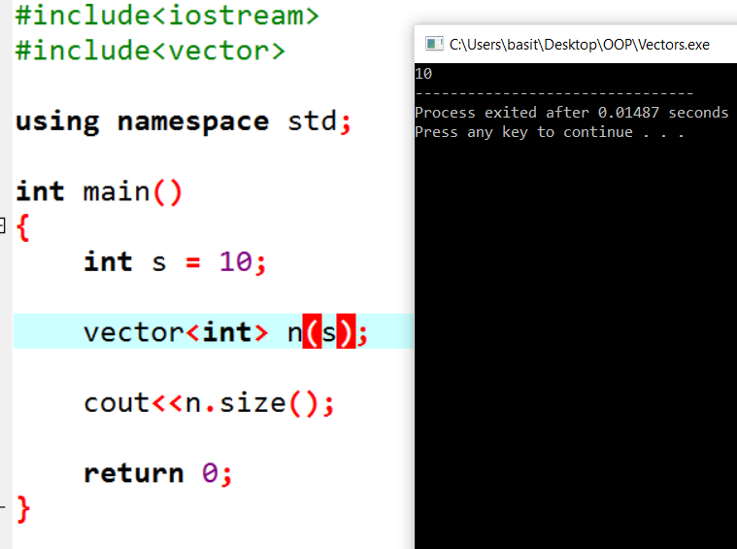
size() function

Slide 9
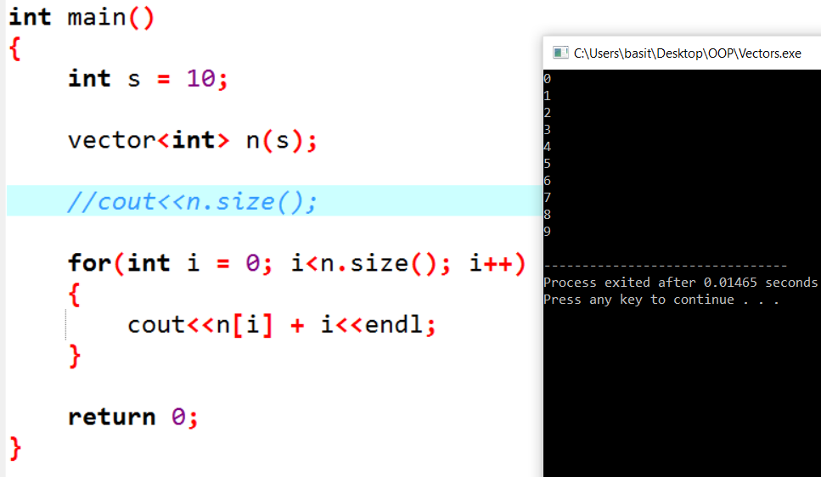
Accessing a Vector

Slide 10
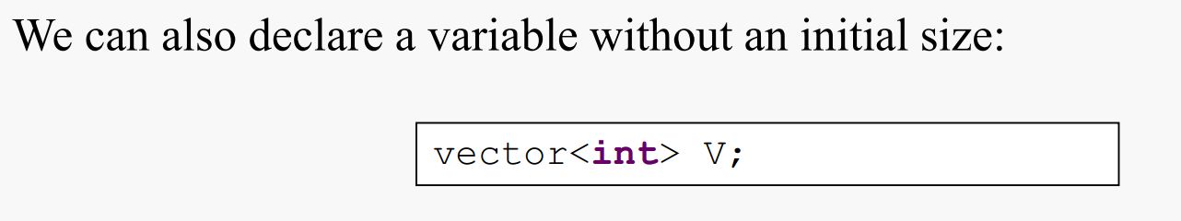
Vectors without an initial size
When we do this, the vector is empty. It has no elements, so you can’t even access V[0]. Calling the size() method will return 0. There is also a method named empty() that returns true if the vector is empty or false if it is not.

Slide 11
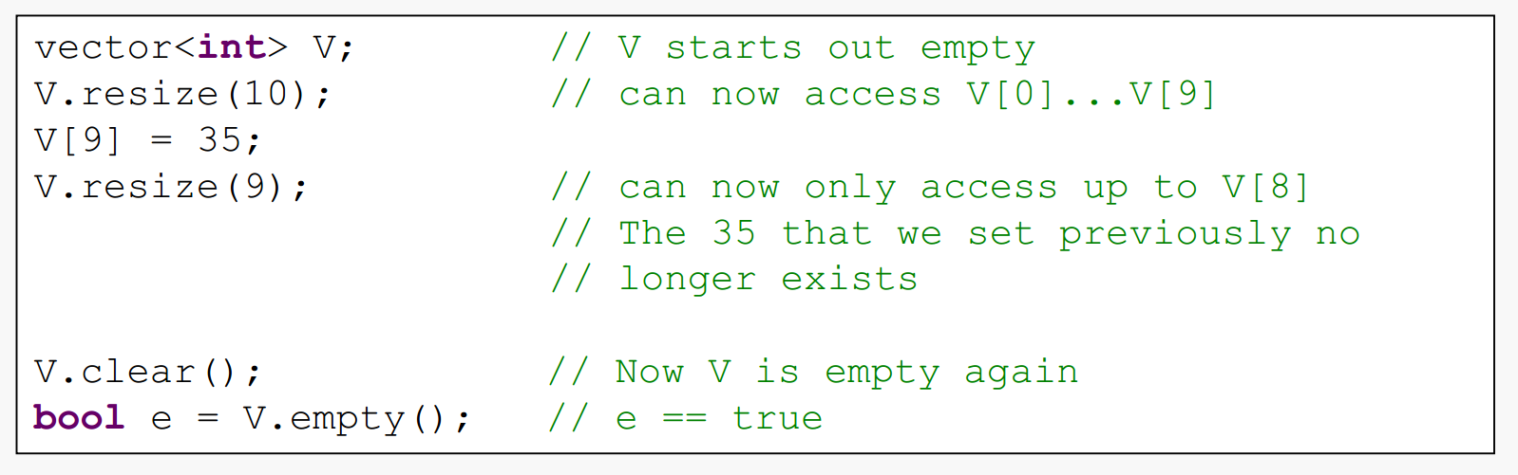
resize() , clear() & empty() functions

Slide 12
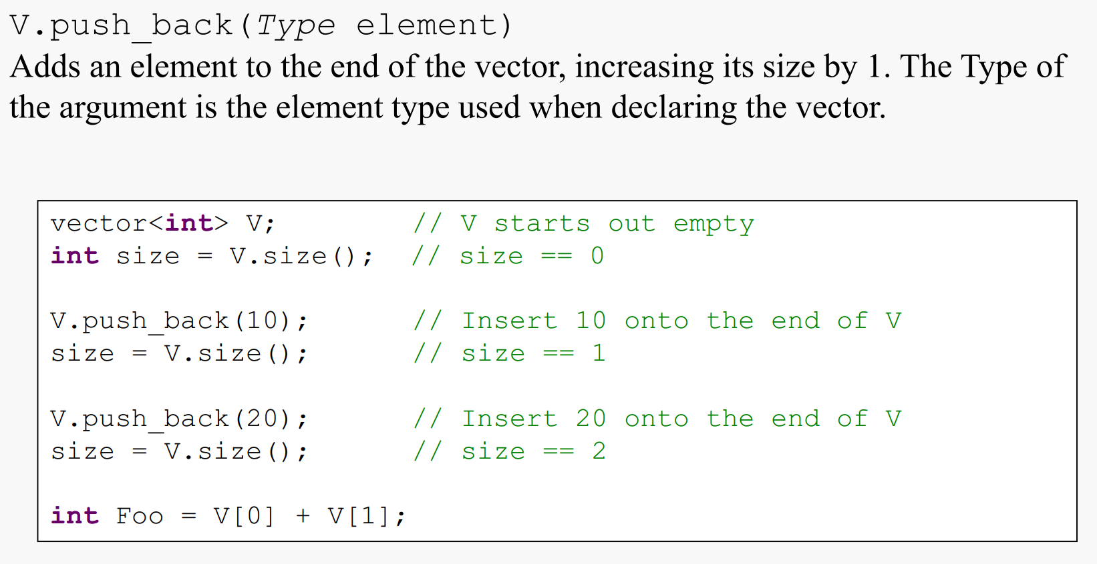
Adding items to a Vector

Slide 13
Containers and Iterators
Vectors provide the concept of an iterator, which is another form of representing the position of an element in the sequence
Recall that elements in a vector of size N are identified by their index, an integer between 0 and N – 1. Iterators implement a similar concept

Slide 14
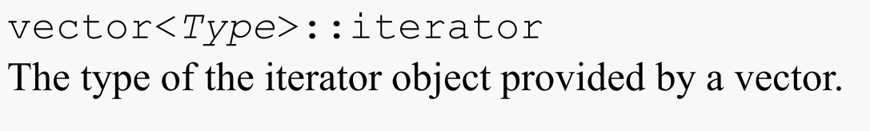
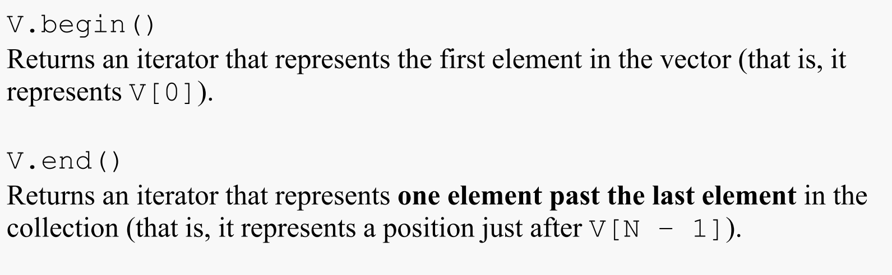
Obtaining an Iterator

Slide 15
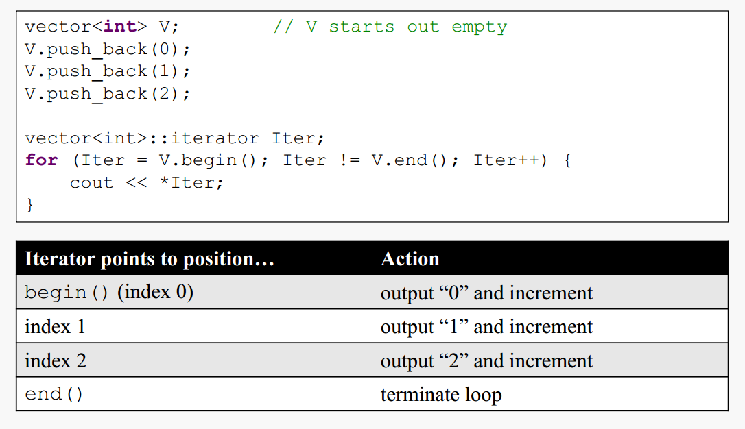
Iterator Example

Slide 16
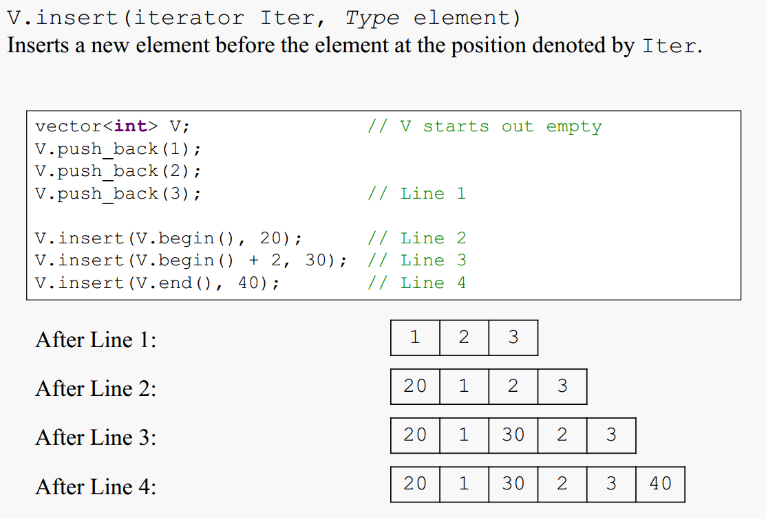
Inserting at Arbitrary Positions

Slide 17
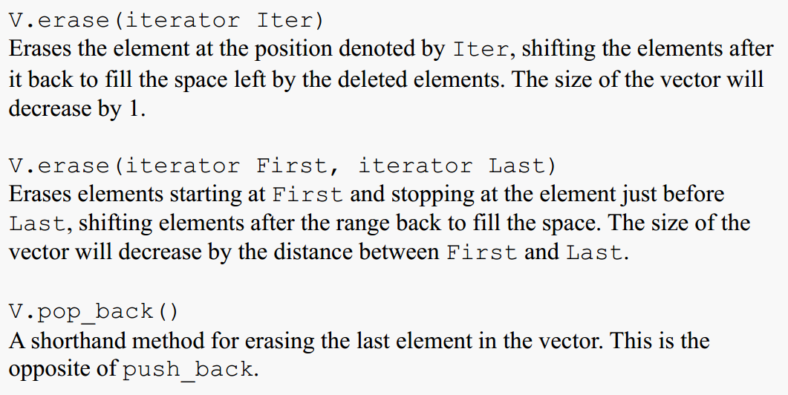
Erasing Elements in a Vector

Slide 18
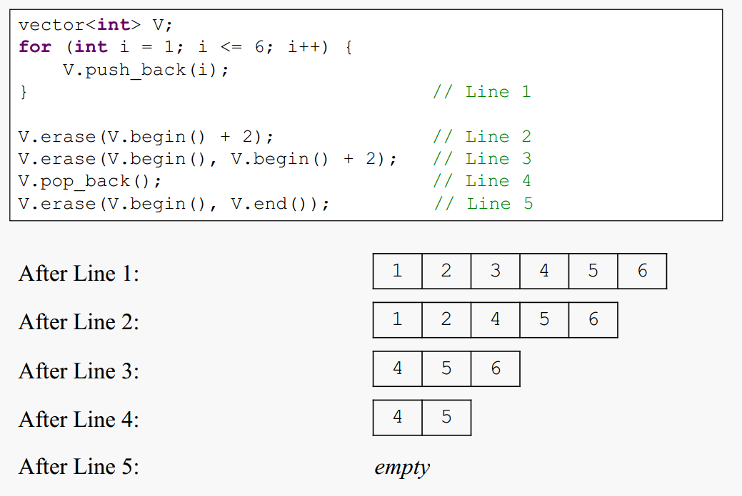
Example

Slide 19
Storing class objects in a Vector
Vectors can store any type of objects (not just built-in types), including those of classes that we create
Example:
vector<MyClass> v;

Slide 20
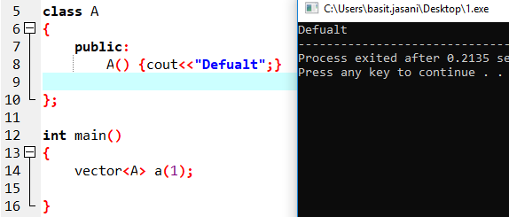
Example

